Slide 1





IPL WINNER PREDICTION
Present By:
17CE037 Jethloja Rohan
Guided by:
Prof. Minal Shah

Slide 2



Presentation outline
02
Why this Project
What is Agenda
How to do
Fact of Cricket
Task to do
Tools & Technology

Slide 3
03
Why This Project
Sports analysis is a very interesting field. Cricket being the most popular sport, has many open area to study. One of this is winner prediction based on previous data.
There is so many form of cricket is available among this T20 is most popular in the world and 104 country is playing T20 formats.
Among all the T20 League Indian Primer League is most popular in word so, I decide to make project on IPL.

Slide 4

04
What is Agenda
The finale outcome of project is to predict the winner of every IPL match.

Slide 5


How to Do
For this project project i have use Cricsheet data set which contain total 757 match records.
Using this dataset apply various Machine Learning algorithm and find best allgorithem which give heigest accuracy for predict winner.
05

Slide 6

Fact Affecting Cricket
06
The Venue
Home ground advantage.
Toss Decisions
Betting first or fielding first due factor.
Strength of the teams
Current form of players.

Slide 7
Task to do
07
01
02
03
Datasets Cleaning
Find best algorithem
GUI Design
In the datasets there is many missing value so apply various data cleaning process on the datasets
There is many algorithm available among this find best algorithm for this project
Design simple GUI where user can enter data and get the predicted result

Slide 8



Tools & Technology
08
+

Slide 9
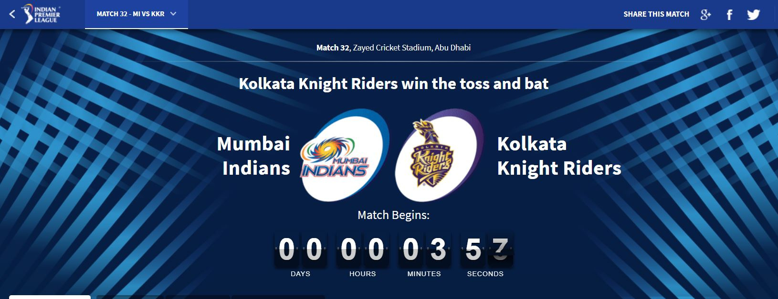
09
Some Snap of Project

Slide 10
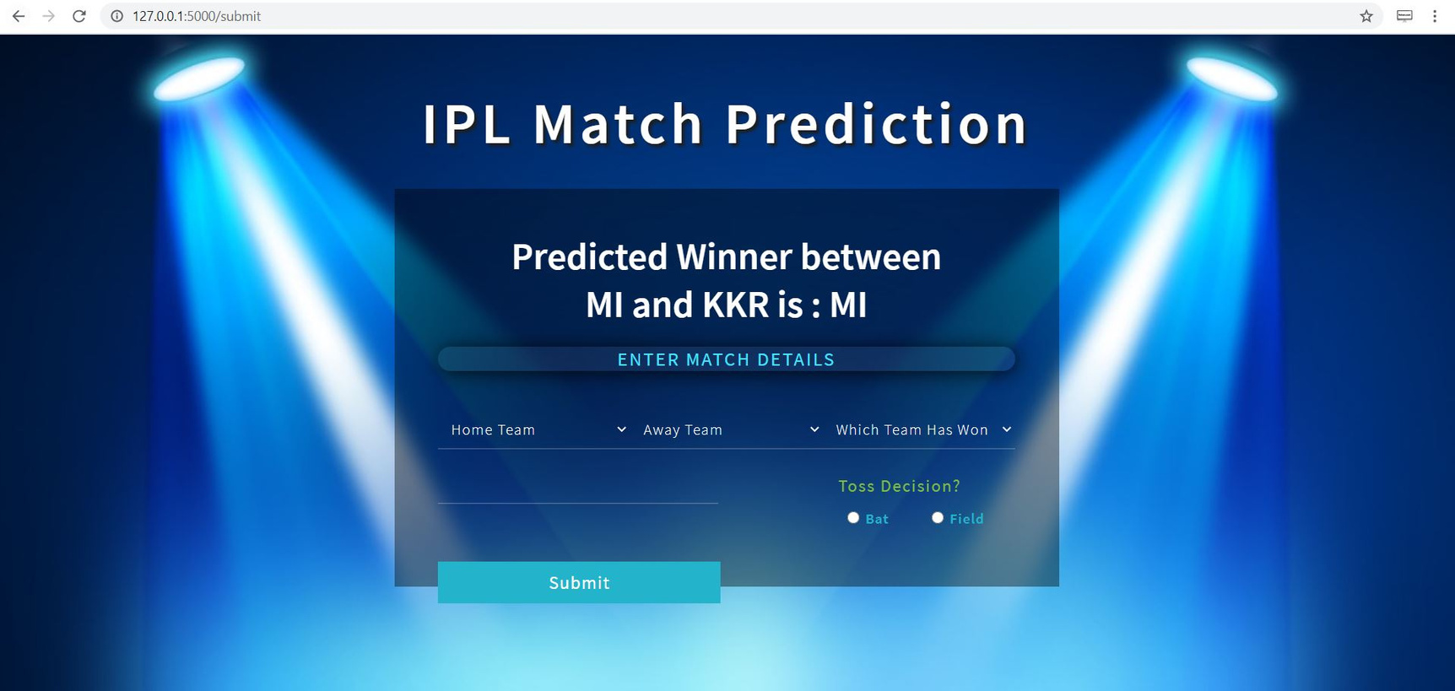
10
Some Snap of Project

Slide 11
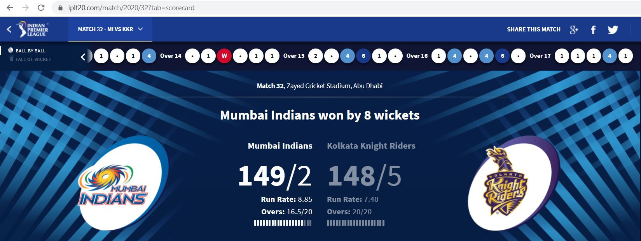
11
Some Snap of Project

Slide 12
Thank You
12
Jethloja Rohan Rajeshbhai
17CE037
Email Address
17ce037@charusat.edu.in
IIPL Winner Prediction
Phone Number
+91 9909194973

